Slide 1
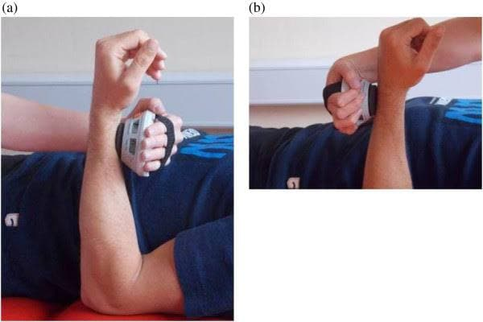
Determining the relationship between elbow and wrist muscle strength with disease activity and functionality in patients with Spondyloarthropathy
Dilara Nur Sırçancı, Ozan Volkan Yurdakul¹
¹Bezmialem Vakıf University, Faculty of Medicine , Istanbul ,Turkey.
²Bezmialem Vakıf University, Faculty of Medicine, Department of physical therapy and rehabilitation, Istanbul, Turkey.
Introduction
Result
Ankylosing spondylitis(AS) is an inflammatory disease that, over time, can cause some of the small bones in your spine (vertebrae) to fuse(1). Given the risk of chronic inflammation and reduced physical activity, patients are also at risk of accelerated muscle wasting(2). We aim to compare the muscle strength of muscle groups in AS patients with the muscle powers of healthy volunteers and to examine the relationship of muscle strengths with disease activity and functionality.
There was no meaningful difference between AS patients and healthy volunteers in terms of muscle strength. The symptom duration was found to have a moderate negative correlation with all the muscle strengths(EF, EE, WF, WE, radial deviation, ulnar deviation). In the patient group, a significant negative correlation was found between the BASDAI and BASFI and all muscle groups.
Result statistics.
Materials and methods
Volunteers age, height(cm), weight(kg) and disease duration(month) informations
A total of 40 males (20 AS, 20 healthy) were included in the study. Bath Disease Activity Index (BASDAI), Functional Index (BASFI), and AS quality of life (ASQoL) scores were recorded. The muscle strength of the participants was measured with the manual hand dynamometer (Lafayette manual muscle tester, Lafayette instrument company, IN, USA) owned by the researcher. The maximum (max) and mean elbow flexion, extension, (EF, EE), wrist flexion, extension (WF, WE), radial deviasion, ulnar deviasion muscle strengths of the patients in both groups were measured.
Bath Ankylosing Spondylitis Disease Activity Index (BASDAI) test: The 5 main symptoms of AS are measured in the questionnaire, where the total score of questions about the activity of the disease is between 0 and 10 (0 = no problem, 10 = worst problem). The resulting 0-50 score is divided by 5 to obtain the final 0-10 BASDAI score. Scores of 4 or higher indicate suboptimal control of the disease, and these patients are often good candidates for a change in their medical management.
Bath Ankylosing Spondylitis Functional Index (BASFI) test: It consists of 10 questions. The first 8 questions evaluate activities related to functional anatomical limitations due to the course of this inflammatory disease. The last 2 questions assess patients' ability to cope with daily life.
AS Quality of Life Questionnaire (ASQol): A disease-specific measure of need-based quality of life developed in the United Kingdom and the Netherlands. In this questionnaire consisting of 18 questions, patients answer the question as 'yes' or 'no'. The score is obtained by adding the number of 'yes' answers. A high score indicates that the disease impairs the quality of life more.
illustration of the hand- held dynamometer measurement
Conclusion
There was no meaningful difference between AS patients and healthy volunteers in terms of muscle strength but the higher the disease activity and functionality, the lower the muscle strength in the AS group. Strengthening specific muscle groups for the desired goal can be a reasonable strategy.
References
Davis JC, van der Heijde D, Dougados M, Woolley JM. Reductions in health-related quality of life in patients with ankylosing spondylitis and improvements with etanercept therapy. Arthritis Rheum. 2005;53:494–501.
Plasqui G, Boonen A, Geusens P, Kroot EJ, Starmans M, van der Linden S. Physical activity and body composition in patients with ankylosing spondylitis. Arthritis Care Res (Hoboken) 2012;64:101–107.

